Slide 1

Business oriented web service application

Slide 2
About company
BizShot is a social news website primarily focusing on establishing a communication link between the investors and the startups with innovative ideas. It also provides service to the local business people to disseminate their business across the city, state, country or even globaly. It serves as a platform specifically for the business people to gather, communicate and to grow together.

Slide 3
Website goals
For Investors - To find a perfect business idea and to invest money in the right business trend based on the current business trends in the news.
For ideas/talent persons - A platform to broadcast their ideas or talent to be recognised by the investors to bring their ideas to implementation.
For Business Expandors - They can post about their current business details and request for interested investors for further establishment of their business globally.

Slide 4
Website goals
The visitors of the site should be able to see the articles in the Articles section about the current trends in the industry and also to ask the Questions on any doubts about their business in the dedicated Q&A section
The visitor can able to register and become a member of the site and this is achieved by providing a Signup option
Exisiting members can Login directly into the site with the Login option
Once the user has logged in they are directed to a dashboard view where they can search about a particular business ideas post or about any investors proposal on investing on a particular idea.

Slide 5
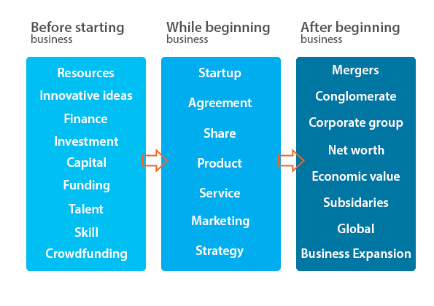
Brainstorming

Slide 6
Competitor analysis
Indirect competitors -
www.reddit.com - This site is user generated questions and replies.
www.digg.com - This system allows users to "digg" or "bury" articles. "Digging" is the equivalent of voting positively, so that popular articles are displayed first. "Burying" does not lower an article's score. However, if an article is buried enough times, it will be automatically deleted from the site
www.voat.co - is similar to reddit where user generated articles.
www.lumn.io - is a social news website where users can submit stories

Slide 7
Target Audience

Slide 8
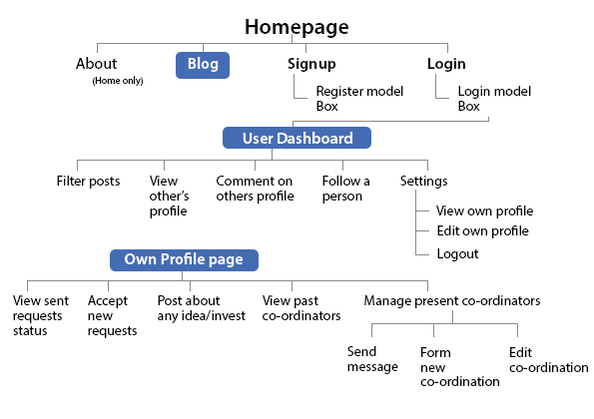
IA - Sitemap

Slide 9
Wireframe

Slide 10
Blocking

Slide 11

Prototype - Desktop

Slide 12

Prototype -Tablet

Slide 13
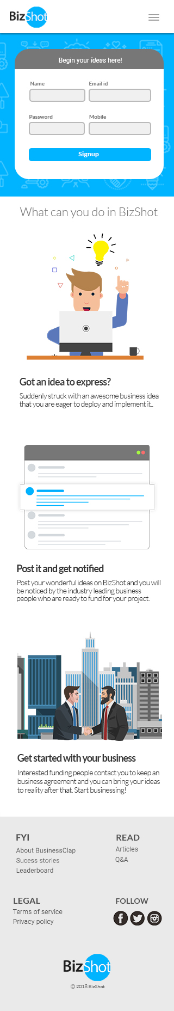
Prototype -Mobile

Slide 14
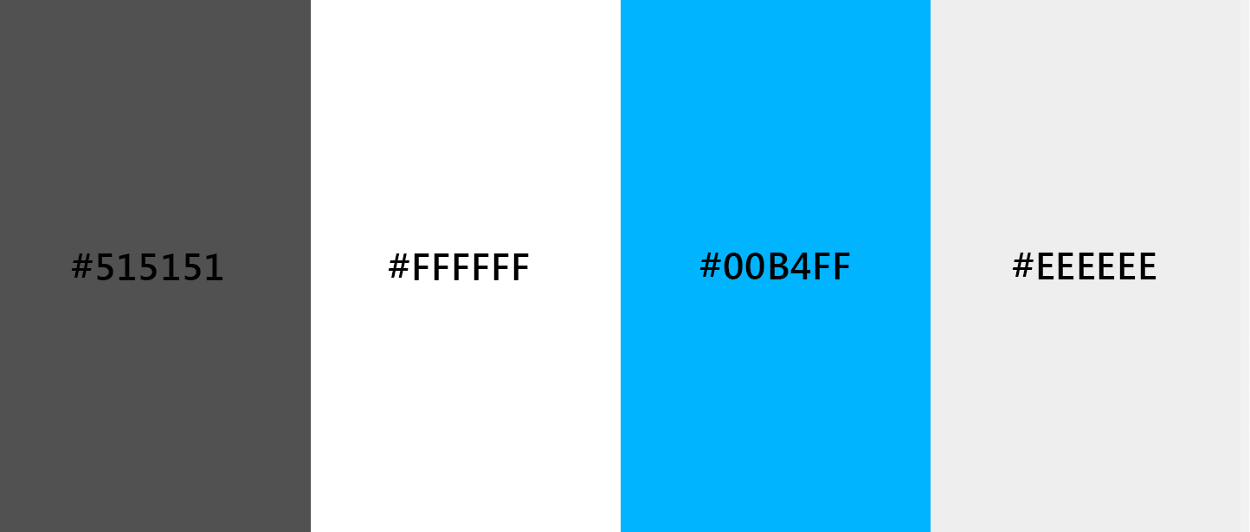
Theme
Blue
Neutrals
Hex codes - #515151
#FFFFFF, #446CB3
#EEEEEE

Slide 15
Typography
Heading - Lato
Sub heading -Lato
Body content - Roboto

